Slide 1
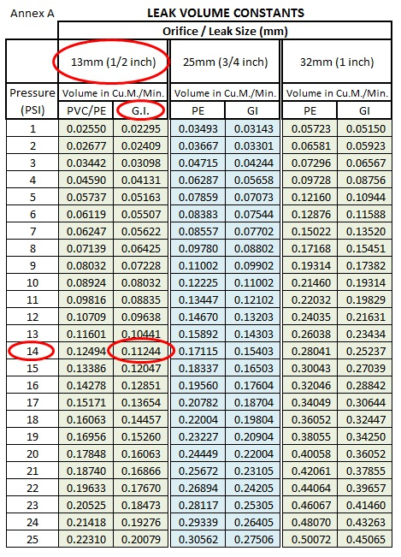
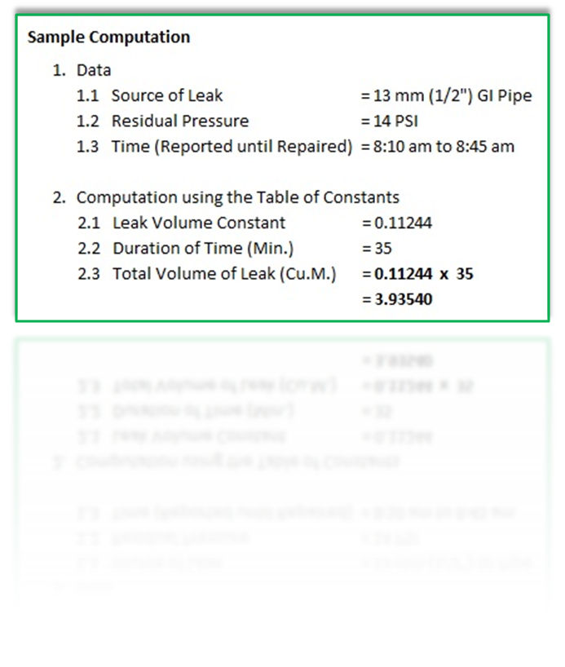

Slide 2
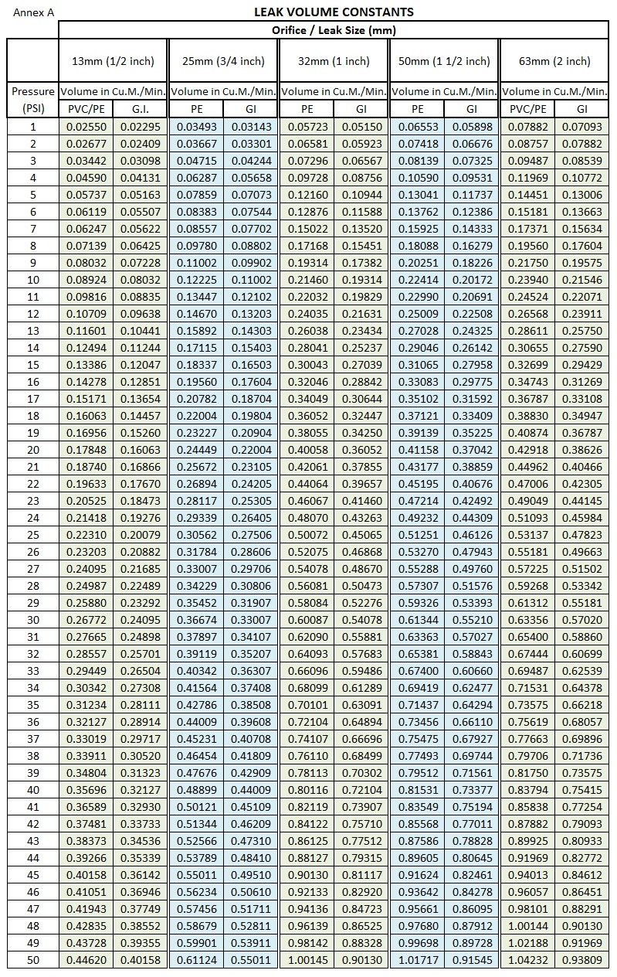

Slide 3
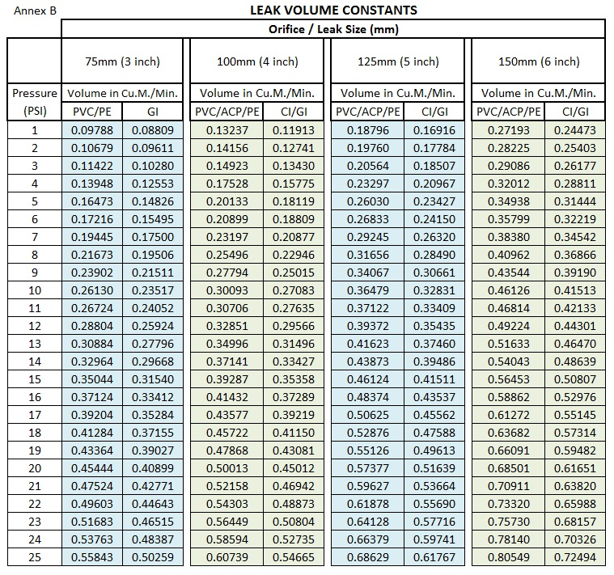

Slide 4
1. REQUIREMENTS FOR HYDRAULIC SIMULATION OF EXISTING BRANCH
1.1 System Maps
1.1.1 Updated Network Maps
1.1.2 Topographic Maps
1.2 Network Attributes (source/pumps and distribution)
1.2.1 24 Hours Hourly Pressure Data (minimum)
1.2.2 24 Hours Hourly Flow/Production Data (minimum)
1.2.3 Valve Settings (fully opened, fully closed, throttled)
1.3 System Operation
1.3.1 Valving Schemes (settings changed daily)
1.3.2 Pump Curve, Power Rating and Operating Time
1.3.3 Cistern/Elevated Tank Volume and Operating Time
1.4 Consumption Data / Monthly Billed Volume
1.5 Consumption Pattern (optional)
2. REQUIREMENTS FOR NEW CAPEX PROJECT HYDRAULIC SIMULATION
2.1 Pipe Extension to Be Interconnected To Existing Network
2.1.1 Scaled Network Map
- Indicate location of the proposed pipe extension and the point of interconnection to the existing pipe network
2.1.2 24 Hours Hourly Flow and Pressure Data Of The Source
2.1.3 Projected 5 year demand/consumption
2.2 Totally New Distribution Network (new source and pipe network)
    2.2.1 Road Network where the pipes will be laid
    2.2.2 Projected 5 year demand/consumption

